Slide 1
The Line of Sight (LOS) System
Guide for Pfizer Vendor and Agency Partners
Document Identifier: BQ-VEN-LOS-01 Version :1.0 Effective date: 01-May-2022

Slide 2



Programs Included
Activities in scope for CP902 are included and are usually sponsored by BUs and Divisions, at the global, regional or country levels, in which there is the potential for interaction between Pfizer or a vendor acting on Pfizer’s behalf and customers (e.g. patients, HCPs) through which Adverse Events and/or other reportable safety information may become evident
Pfizer
Pfizer
Interaction
Interaction
or
Health Care Professional
Patient / Other customers
Document Identifier: BQ-VEN-LOS-01 Version :1.0 Effective date: 01-May-2022

Slide 3
What You Will Learn from this Guide
You will be able to:
Understand the function of the Line of Sight (LOS) system
Gain Access to LOS
Assign personnel
in LOS
Troubleshoot
Document Identifier: BQ-VEN-LOS-01 Version :1.0 Effective date: 01-May-2022

Slide 4
What Is the Line of Sight (LOS) System?
Document Identifier: BQ-VEN-LOS-01 Version :1.0 Effective date: 01-May-2022

Slide 5
LOS…
Is a controlled system and can be utilized during an audit or inspection
Is a user-friendly platform that tracks vendor personnel working on a program and the training completion status of those assigned to a Program record.
Was designed to provide Pfizer Program Owners (POs) oversight of vendor training and personnel assignments
Is ‘read only’ for Pfizer colleagues, including POs
Only vendors can input and edit data in LOS
Defaults to English but can be changed to 23 other languages via the “Preferred Language” feature
Document Identifier: BQ-VEN-LOS-01 Version :1.0 Effective date: 01-May-2022

Slide 6
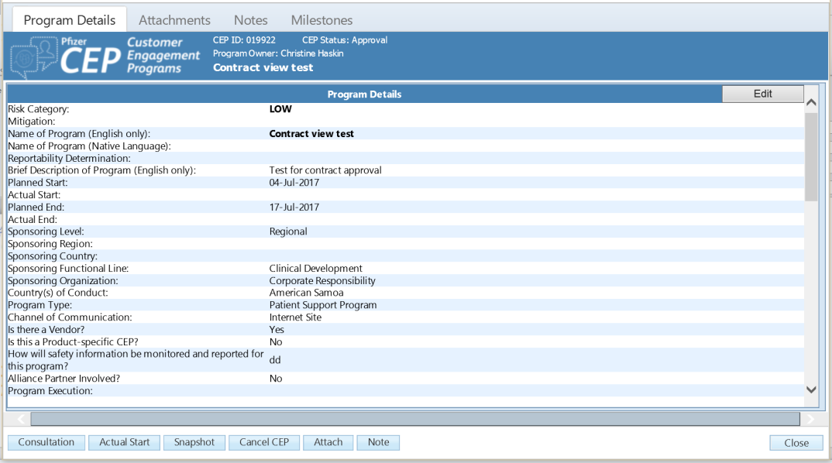



The LOS Receives Data from the Program Inventory and Pfizer Learning Management System
Program Inventory
Program Inventory
Provides to LOS
  Contains a historical record of all Activities
  Projects are input by POs
  Program Owner
  Project Name
  Project Description
  BU / Stakeholder
  Country of Conduct
  Planned Start Date
  Actual Start Date
  Planned End Date
  Actual End Date
  Vendor Contact Info
  And more…
LMS
LMS Provides to LOS
LOS Is Updated
24 Hours (at a Minimum)
  Online training system
  List of certified vendor personnel
Document Identifier: BQ-VEN-LOS-01 Version :1.0 Effective date: 01-May-2022

Slide 7


Vendor Roles and Responsibilities
Activities | VPM* | VAA* Only
Vendor contacts needed in Program Inventory
Automated invitations sent by LOS
Manual invitations sent from LOS (sent by BQ Lead* / VPM)
Must complete “YRR for Vendors”
Must complete “The Line of Sight (LOS) Guide for Vendor and Agency Partners” (this document)
Creating account in LOS
Responsible for vendor account administration activities
Assigning and removing personnel from a Program record
Responsible for Program execution Oversight
VPM* – Vendor Project Manager, BQ Lead* – Biopharma Quality Lead, VAA* – Vendor Account Administrator.
Document Identifier: BQ-VEN-LOS-01 Version :1.0 Effective date: 01-May-2022

Slide 8
The Two Categories of Vendor Personnel:
LOS Users
Vendor Project Manager (VPM)
Usually, the project leader for the program
  Possible to have more than one VPM, especially for multi-country programs
Decides who within their agency (including subcontractors) will support the Program
  Uses LOS to invite any personnel / subcontractors who do not fulfill Program requirements to do so
  Invitations must be sent to valid, professional email addresses; do not use personal email addresses
  Each person must have a unique email address; do not use distribution lists or mailboxes
  Reminders can be sent from LOS to those who have already been invited
Uses LOS to assign personnel (including themselves) to the Program record
Vendor Personnel (VP)
Added to the Program record by the VPM
May engage in two-way interaction with customers
All LOS users must complete “YRR for Vendors” AND “The Line of Sight (LOS) Guide for Vendor and Agency Partners” courses in LMS
Document Identifier: BQ-VEN-LOS-01 Version :1.0 Effective date: 01-May-2022

Slide 9
Using LOS
Document Identifier: BQ-VEN-LOS-01 Version :1.0 Effective date: 01-May-2022

Slide 10
Using LOS for a Program
Gaining Access to LOS
Assigning personnel to a Program record
  Adding and deleting personnel from a Program record
Inviting Personnel and Subcontractors
  Inviting personnel to take the “YRR for Vendors” and/or “The Line of Sight (LOS) Guide for Vendor and Agency Partners” courses in LMS
  Creating an account in LMS
  Completing YRR and LOS training(s) in LMS
  Creating an account in LOS
  Setting up / Changing a password
Document Identifier: BQ-VEN-LOS-01 Version :1.0 Effective date: 01-May-2022

Slide 11
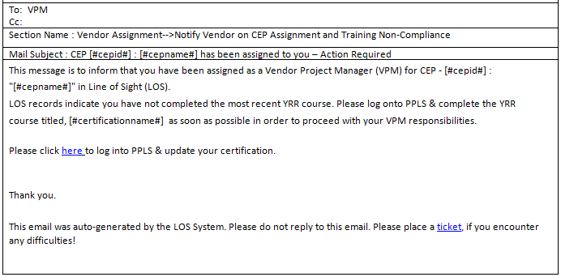
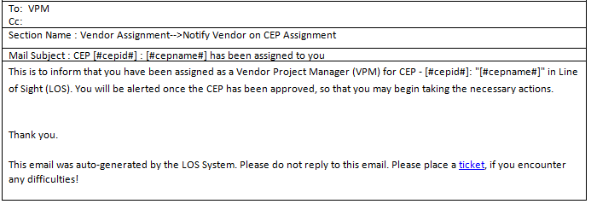
Gaining Access as a VPM (1/2)
The first steps of the process are initiated by the Program
Owner (PO)
  The PO opens a new record in the Program Inventory
  PO adds the Vendor Program Manager’s (VPM’s) name & email address to the Program record
  LOS sends an alert email to the VPM
  If the VPM has not completed the most recent YRR course, or does not have an account in LMS, LOS will prompt the VPM
Document Identifier: BQ-VEN-LOS-01 Version :1.0 Effective date: 01-May-2022

Slide 12
Gaining Access as a VPM (2/2)
Once the Program has reached the “Active” Stage
Log into Dashboard
Add yourself as personnel to the Program record
Add other vendor personnel from your organization, subcontractors from outside of your organization or invite personnel not found in LOS
Document Identifier: BQ-VEN-LOS-01 Version :1.0 Effective date: 01-May-2022

Slide 13
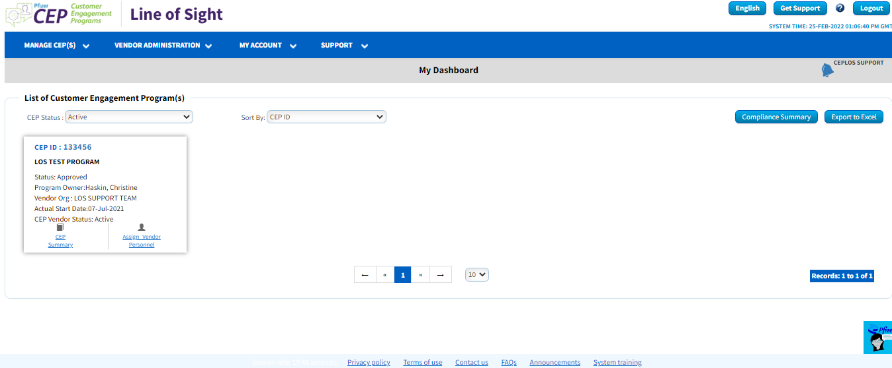
LOS Dashboard Features (1/4)
Each Program Is Represented by a Tile
Quick Navigation Toolbar at Top of Dashboard
Drop Down Provided to Search Functionality
Access System Training, Recent Announcements and Other Information
Via the Link at the Bottom of the Dashboard
Document Identifier: BQ-VEN-LOS-01 Version :1.0 Effective date: 01-May-2022

Slide 14
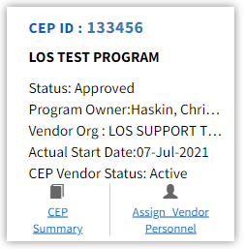
LOS Dashboard Features (2/4)
Click on the Active Links in Each Program Tile for Specific Details or Actions
Document Identifier: BQ-VEN-LOS-01 Version :1.0 Effective date: 01-May-2022

Slide 15
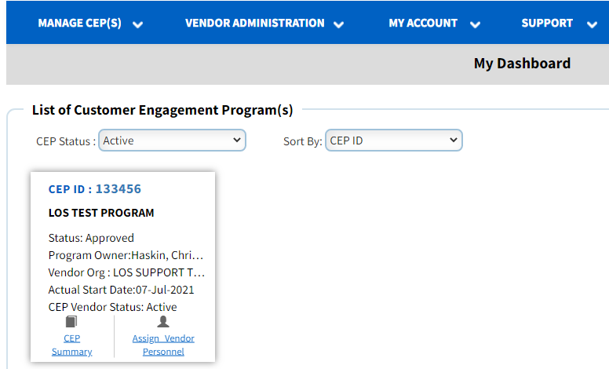
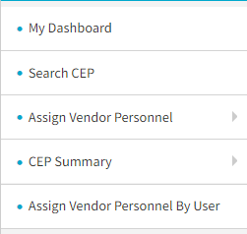
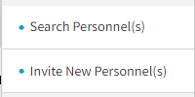
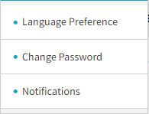
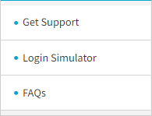
LOS Dashboard Features (3/4)
The Toolbar at the Top of the Dashboard Will Take You to Specific Areas within LOS
Document Identifier: BQ-VEN-LOS-01 Version :1.0 Effective date: 01-May-2022

Slide 16
LOS Dashboard Features (4/4)
English
  Select one of 23 languages in which you would like to view LOS. This can be done via the toolbar drop down or the language button (Note: All reporting & input must be in English
?
  Clicking the “?” at the top of the page provide detailed information about the specific area you’re on
Get Support
  If any technical issues are encountered, use the “Get Support” button or toolbar drop down to submit a ticket
Logout
  When you are finished, click “Log Out” at the top right of
  your screen
Document Identifier: BQ-VEN-LOS-01 Version :1.0 Effective date: 01-May-2022

Slide 17
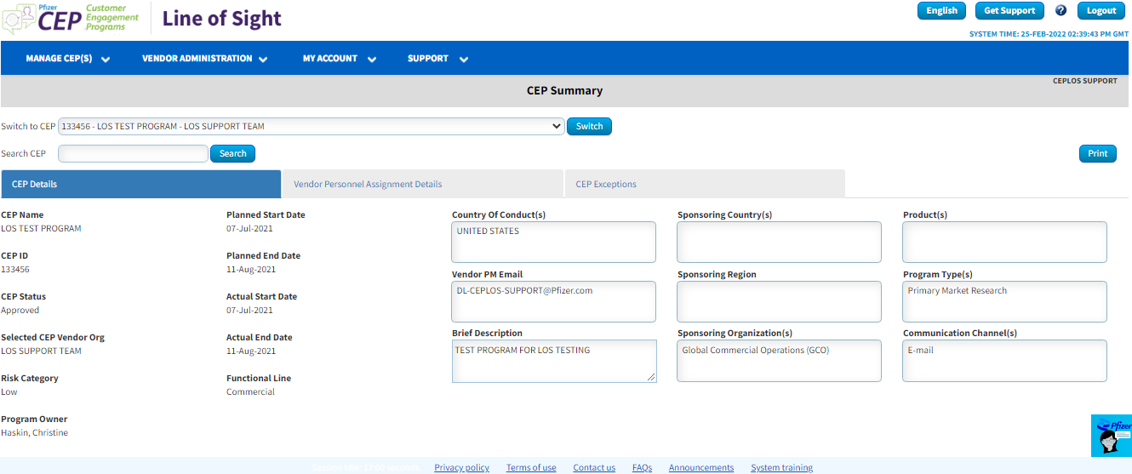
Program Summary Page: Program Details Tab
Contains All Information Migrated from the Program Inventory
“Switch to CEP” drop down feature allows quick toggling between active Programs
A “search CEP” option is available to search Programs (both active and inactive) by providing Program ID
Document Identifier: BQ-VEN-LOS-01 Version :1.0 Effective date: 01-May-2022

Slide 18
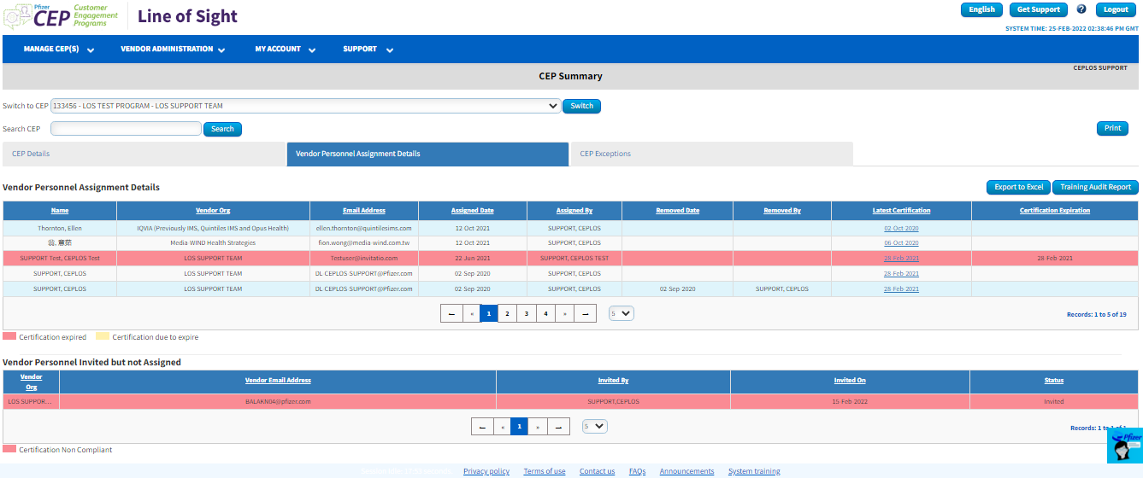
Program Summary Page: Vendor Personnel Assignment Details Tab
Provides a Summary View of All Personnel Assigned or Invited to the Program record
Switch to another Program record to easily review personnel training compliance for all your agency’s Programs
Training Audit Report button provides quick, printable report for audits
Vendor Personnel Invited but Not Assigned Shows Personnel Who You Have Invited but Have Not Fulfilled All Requirements to Work on a Pfizer Program
Document Identifier: BQ-VEN-LOS-01 Version :1.0 Effective date: 01-May-2022

Slide 19
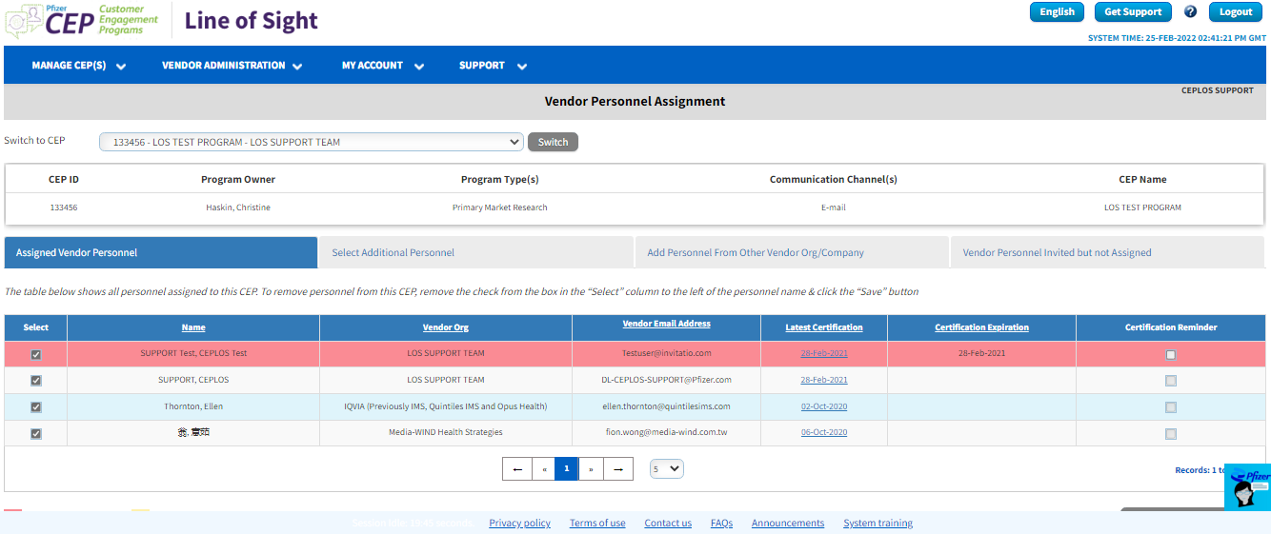
Assigning Personnel (1/2)
A VPM’s First Task Is to Assign Personnel
Select available personnel to add to the Program record in the ‘Select Vendor personnel From your Org’ tab
Assign ALL personnel working on the project to the Program record, including yourself and any contractors and/or recruiters
Document Identifier: BQ-VEN-LOS-01 Version :1.0 Effective date: 01-May-2022

Slide 20
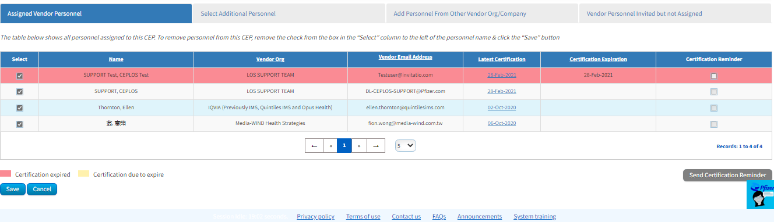
Assigning Personnel (2/2)
Provides information concerning vendor personnel assigned to the Program record
  Date of most recent YRR course completion
  Expiration of YRR Certification
  Date added to Program record
  Date removed from Program record
Each tab provides access to a different group
  A brief summary of the tabbed sections and how to use it is provided at the top of each section
Document Identifier: BQ-VEN-LOS-01 Version :1.0 Effective date: 01-May-2022

Slide 21
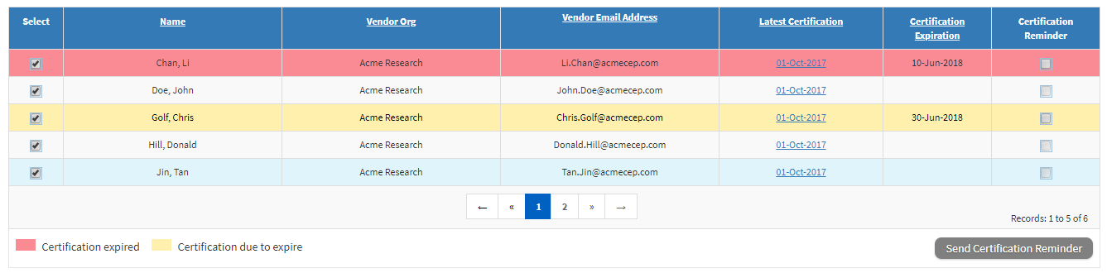
Assigning Personnel: Select Additional Personnel
Select the box next to the names of personnel to be assigned
  Personnel whose YRR certification has expired, or will expire with the next 30 days, cannot be assigned to a project
  Send these personnel a reminder to complete the most recent YRR course in LMS
Document Identifier: BQ-VEN-LOS-01 Version :1.0 Effective date: 01-May-2022

Slide 22
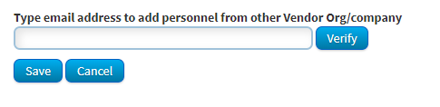
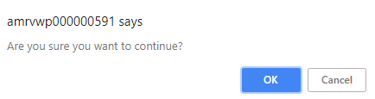
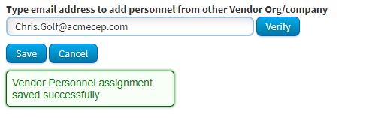
Assigning Personnel: Add Personnel from Other Vendor Org / Company
To Assign Personnel From Your Organization Not Appearing in Your Organization’s List
Type the User’s Name & Save Changes
Confirm You Want to Continue
Verify Green Box with Confirmation Message Appears
Document Identifier: BQ-VEN-LOS-01 Version :1.0 Effective date: 01-May-2022

Slide 23
Assigning Personnel: Add Personnel from Other Vendor Org / Company
Personnel from other organizations are also eligible to be added to a program record providing the following requirements are completed
  Added to LOS by any vendor organization
  Most recent YRR completed in LMS
  Includes recruiters, subcontractors, moderators, etc.
  Use the same method as noted in previous slide to assign personnel from your organization not appearing in your organization’s list
  If the personnel cannot be found in LOS, send an invitation
Document Identifier: BQ-VEN-LOS-01 Version :1.0 Effective date: 01-May-2022

Slide 24
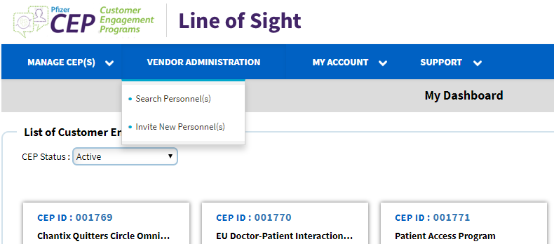
Inviting New Personnel (1/5)
Why Invite New Personnel?
In order to add personnel to a Program record, the personnel must be found in LOS
If personnel cannot be found in LOS, they may be new to Pfizer’s process & will need to be added
How to Invite New Personnel?
The VPM adds new personnel’s email address to LOS which prompts LOS to generate an invitation
Select “Invite Personnel” from toolbar across the top of your Dashboard
1
Document Identifier: BQ-VEN-LOS-01 Version :1.0 Effective date: 01-May-2022

Slide 25
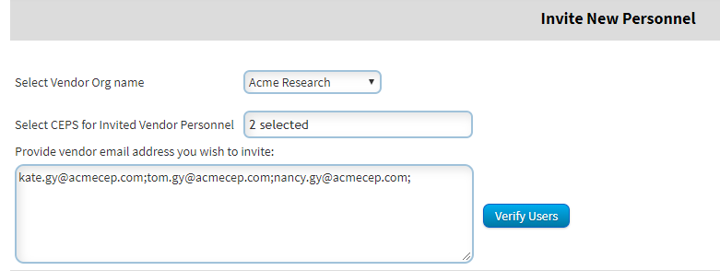
Inviting New Personnel (2/5)
How to Invite Personnel?
Next, Add the Email Addresses of the New Personnel
Do not use personal email accounts unless approved by PO
Separate each email with a semi-colon or use separate lines
Alternatively, cut and paste larger lists of email addresses
Double check that the vendor's name is correct
2
Document Identifier: BQ-VEN-LOS-01 Version :1.0 Effective date: 01-May-2022

Slide 26
Inviting New Personnel (3/5)
How to Invite Personnel?
Once all email address have been added, click the “Verify Users” button
3
Document Identifier: BQ-VEN-LOS-01 Version :1.0 Effective date: 01-May-2022

Slide 27
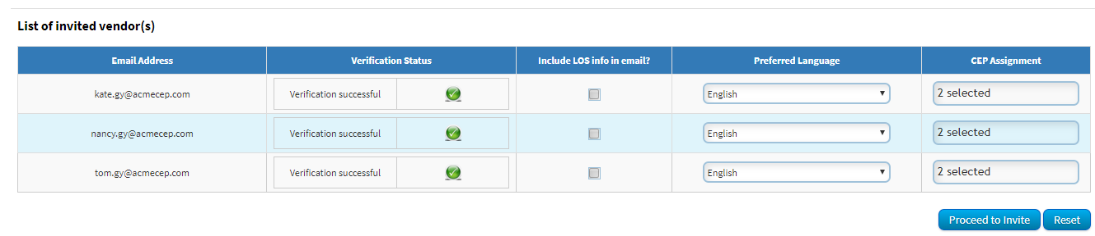
Inviting New Personnel (4/5)
How to Invite Personnel?
If you have entered a valid email address, the system will return a “verification
successful” status
If you’ve made any errors (such as abc@acme.coz rather than .com), LOS will return an error message
If you’ve entered the email address of a colleague who has already been invited, LOS will alert you that s/he has already been invited
PLEASE NOTE: If the personnel will not be managing vendor personnel in LOS, do NOT check the “Include LOS in email” box
Once the emails are verified, click the “Proceed to Invite” button
4
5
Document Identifier: BQ-VEN-LOS-01 Version :1.0 Effective date: 01-May-2022

Slide 28
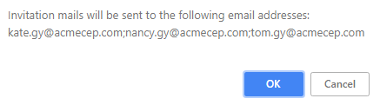
Inviting New Personnel (5/5)
How to Invite Personnel?
After clicking the “Proceed to Invite” button, LOS will provide the following message
Click “OK” to complete the process and send invitations
6
7
Document Identifier: BQ-VEN-LOS-01 Version :1.0 Effective date: 01-May-2022

Slide 29
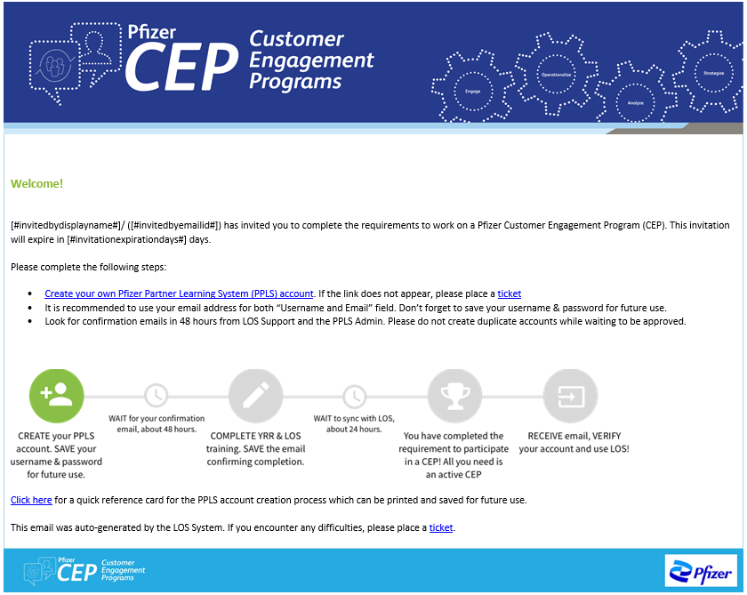
Example of an Invitation Email
Document Identifier: BQ-VEN-LOS-01 Version :1.0 Effective date: 01-May-2022

Slide 30
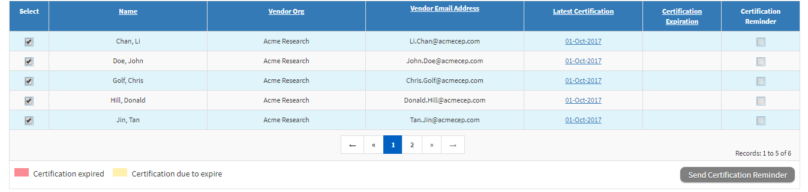
Removing Personnel
Add or Remove Personnel at Any Time During the Program as changes occur
Remove check mark next to the name in Select column
Save changes
Confirm you want to continue
Verify green box with confirmation message appears
Document Identifier: BQ-VEN-LOS-01 Version :1.0 Effective date: 01-May-2022

Slide 31
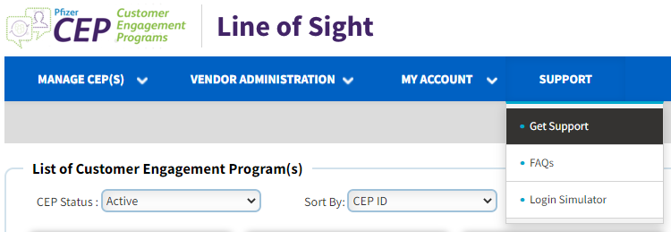
Removing Personnel
IMPORTANT!
Remove personnel from active Program records as soon as they leave your organization or no longer work on Pfizer projects.
Next, place a ticket through the ‘Get Support’ option to have the account deactivated
Document Identifier: BQ-VEN-LOS-01 Version :1.0 Effective date: 01-May-2022

Slide 32
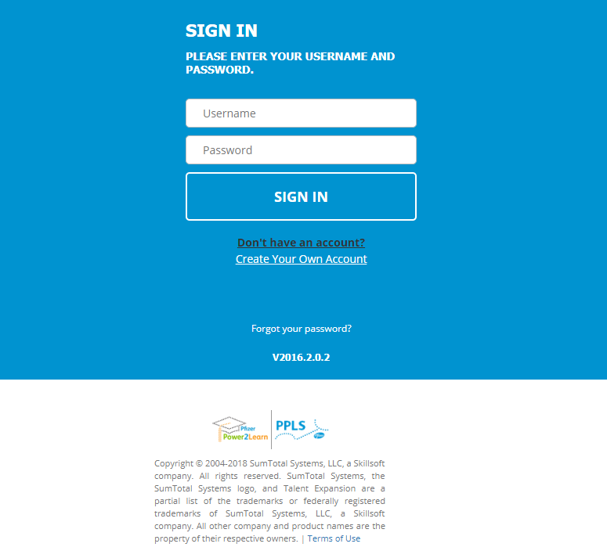
Creating an LMS Account: LMS Landing Page
When you click the link in the email from LOS, it will bring you to this page
Click on the “Create your own account” link to set up your account in LMS
  Input your email address as your username
  You will also designate your password
  Pfizer Sponsor should be input
Remember – it takes
24-48 hours for Pfizer to approve the creation of your account. Personnel should not attempt login before the approval email is received.
  If the approval email doesn’t arrive within 72 hrs., contact your Pfizer Contact Point for follow up
  Don’t forget to check your junk/spam folder
Document Identifier: BQ-VEN-LOS-01 Version :1.0 Effective date: 01-May-2022

Slide 33
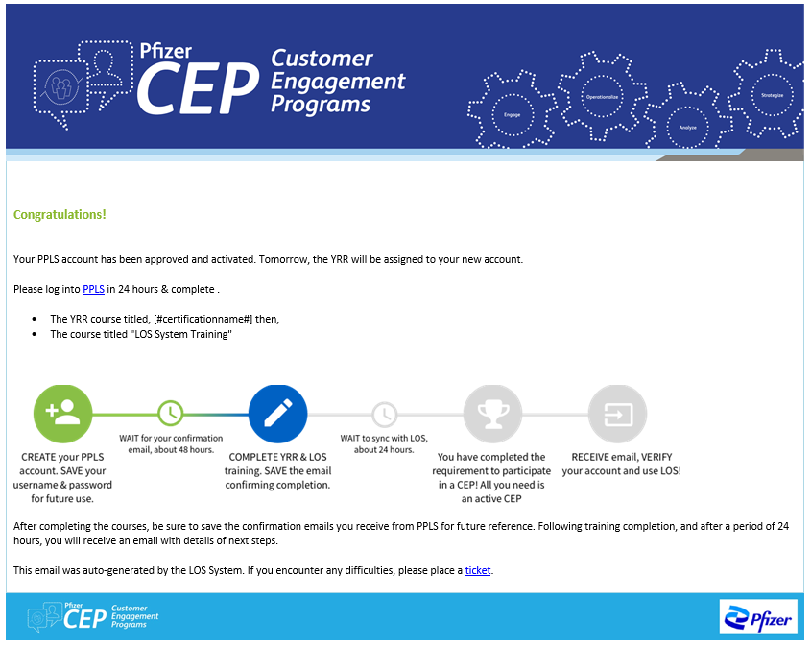
Creating an LMS Account:
Account Approval Notification Will Be Sent
Document Identifier: BQ-VEN-LOS-01 Version :1.0 Effective date: 01-May-2022

Slide 34
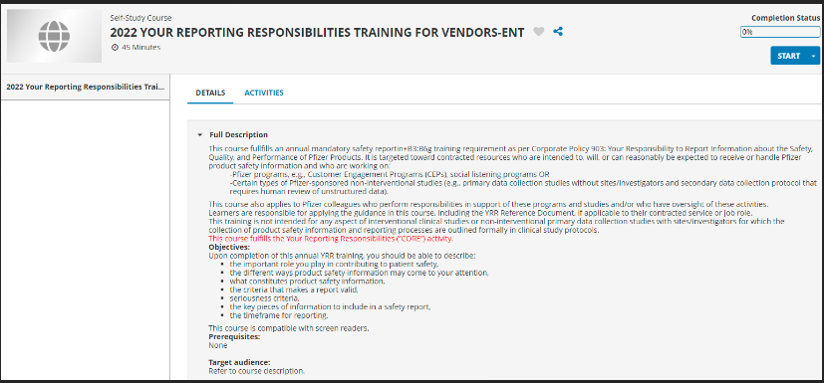
Completing Training: The “YRR for Vendors” Course
Click the ‘Start’ Button
Click on Start
Document Identifier: BQ-VEN-LOS-01 Version :1.0 Effective date: 01-May-2022

Slide 35
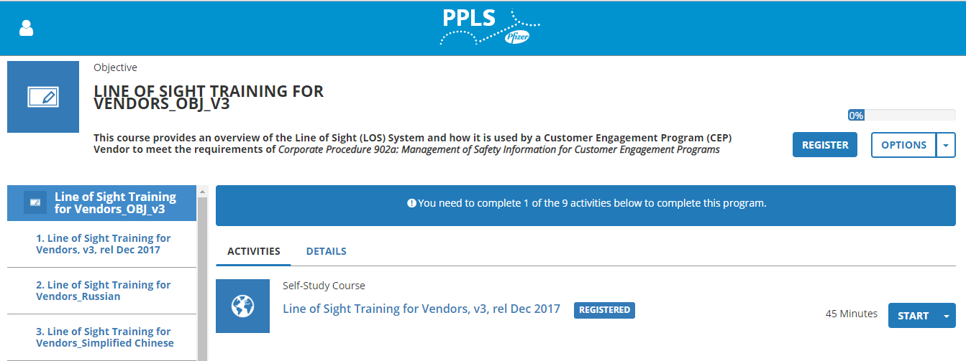
Completing Training: The “The Line of Sight (LOS) Guide for Vendor and Agency Partners ” Course
Click the ‘Register’ Button
Click on Start
Then, Select the Start Button for the Language of Your Choice
Document Identifier: BQ-VEN-LOS-01 Version :1.0 Effective date: 01-May-2022

Slide 36
Completing Training: Confirmation of Completion Will Be Sent
** NOTE: Save these emails for future reference**.
Document Identifier: BQ-VEN-LOS-01 Version :1.0 Effective date: 01-May-2022

Slide 37
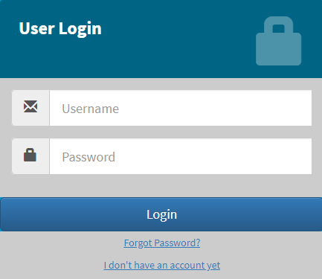
Creating an LOS Account
Upon Completing the Required Course(s) in LMS, Navigate to LOS
and Create an Account (wait 24 hours for system synch)
http://ceplos.pfizer.com
To create your account, click “I don’t have an account yet” to begin the process
1
Document Identifier: BQ-VEN-LOS-01 Version :1.0 Effective date: 01-May-2022

Slide 38
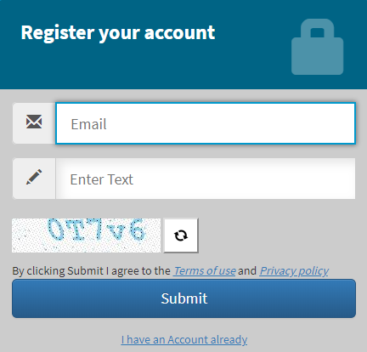
Creating an Account in LOS (1/2)
Enter your email address (which will be your username going forward), the letter / number combination from the captcha and then hit ‘submit’
  Please use the same login credentials used to create your LMS account.
2
Document Identifier: BQ-VEN-LOS-01 Version :1.0 Effective date: 01-May-2022

Slide 39
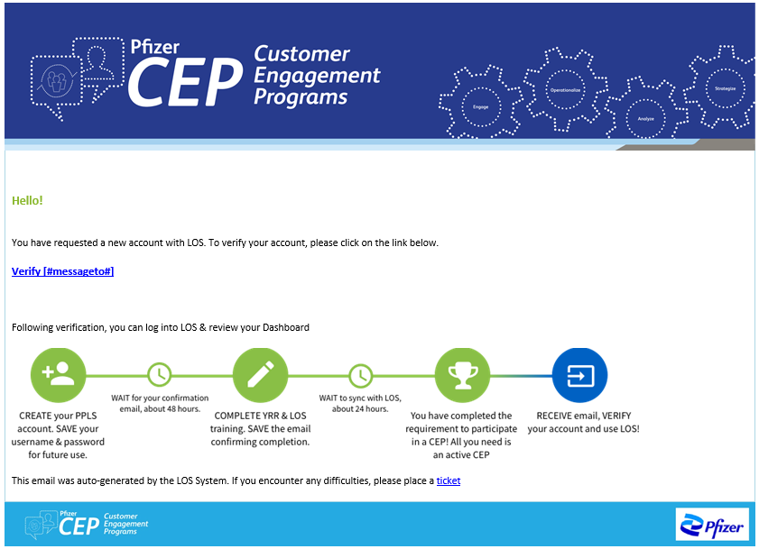
Creating an Account in LOS (2/2)
Follow the directions in the verification email sent from LOS
3
Document Identifier: BQ-VEN-LOS-01 Version :1.0 Effective date: 01-May-2022

Slide 40
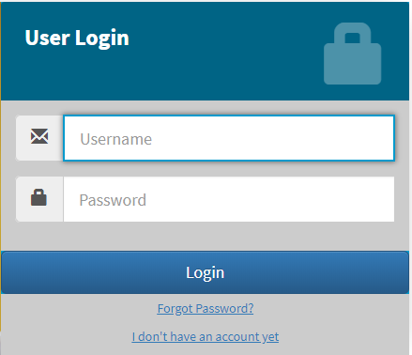
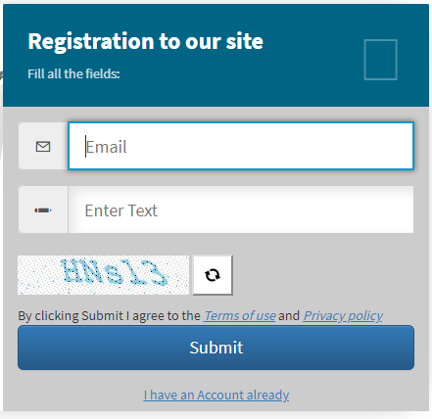
Resetting Your LOS Password
If you forget or need to reset your password, click ‘Forgot Password?’ on the login screen
Similar to creating a new account, enter your email address, the letter / number combination from the captcha and hit submit
The system will email you a link to LOS that will allow you to reset your password
Please note that your passwords will expire every 120 days
Document Identifier: BQ-VEN-LOS-01 Version :1.0 Effective date: 01-May-2022

Slide 41
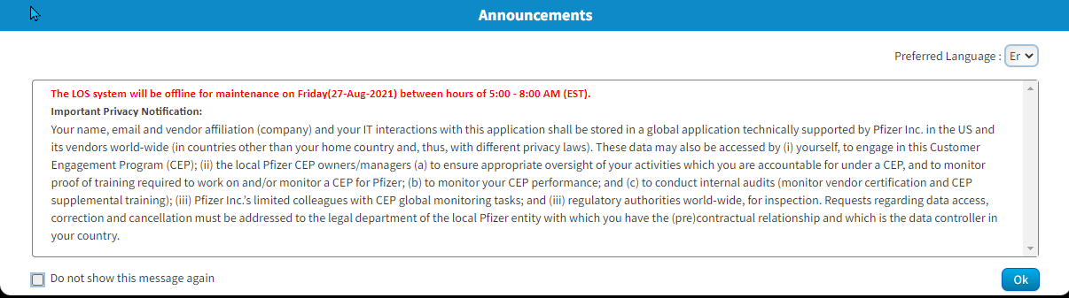
Accessing LOS (1/2)
When You First Access LOS, You Will Be Provided with Announcements
Upon reading the announcements, you have the option to select the ‘Do not show this message again’
When new information is available, announcements will appear before you can proceed to the Dashboard
Announcements are also accessible via the footer toolbar on your Dashboard
Document Identifier: BQ-VEN-LOS-01 Version :1.0 Effective date: 01-May-2022

Slide 42
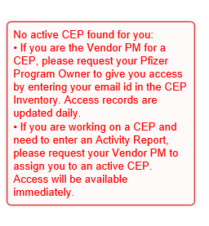
Accessing LOS (2/2)
If You Are Unable to Logon to the System, LOS Will Let You Know the Reason Why
The most common reason users cannot access LOS is because they are not assigned to an active Program record
Vendor personnel are only able to access LOS if they are either the VPM for a Program, or have been assigned as personnel to the Program record by the VPM
Document Identifier: BQ-VEN-LOS-01 Version :1.0 Effective date: 01-May-2022

Slide 43


TROUBLE SHOOTING
Email alerts
Trouble shooting LMS or LOS access
Technical problems with LMS
LOS Exceptions: Programs not using LOS
What to do when LOS is down
Document Identifier: BQ-VEN-LOS-01 Version :1.0 Effective date: 01-May-2022

Slide 44
Email Alerts
LOS Will Send out Email Alerts to the VPM
  Welcome Email
  User and New User Invitation Email
  Vendor Assignment
VPM Specific Alerts from LOS
  Program-related training is nearing expiration
Document Identifier: BQ-VEN-LOS-01 Version :1.0 Effective date: 01-May-2022

Slide 45
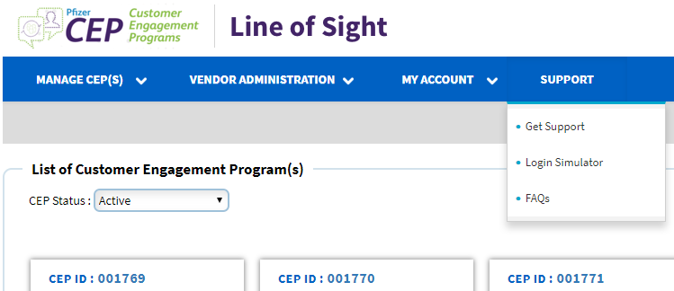
Troubleshooting LMS or LOS Access as VPM (1/3)
VPMs Can Assist Personnel with Log in Issues by Accessing
the Login Simulator
Document Identifier: BQ-VEN-LOS-01 Version :1.0 Effective date: 01-May-2022

Slide 46
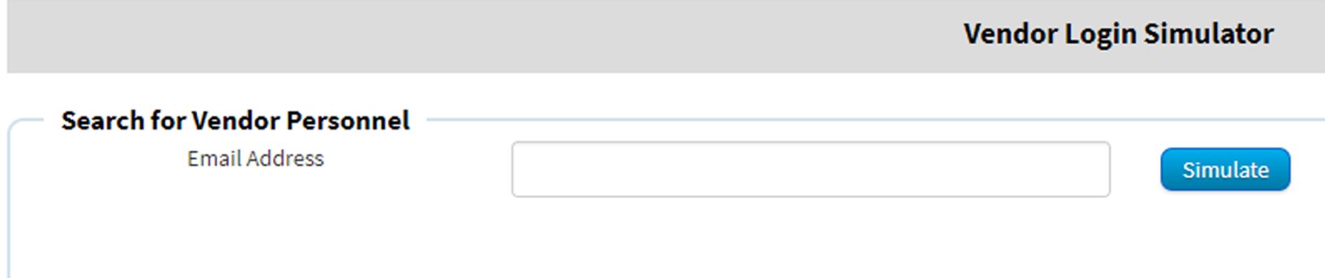
Troubleshooting LMS or LOS Access as a VPM (2/3)
Input the Email Address of the Personnel Encountering Difficulty,
Then Click “Simulate”
The Login Simulator Will Provide Information Regarding
the Account, Including
  If an account has been created in LMS
  Whether all Program-related courses have been completed
  If an LOS account has been created
  If the password has expired
  List of Programs to which the personnel is assigned
Document Identifier: BQ-VEN-LOS-01 Version :1.0 Effective date: 01-May-2022

Slide 47
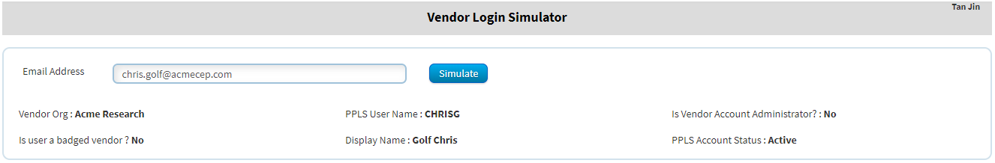
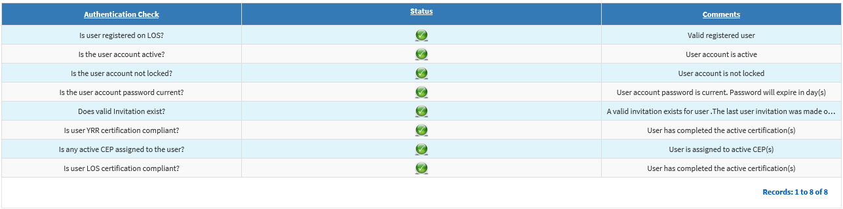
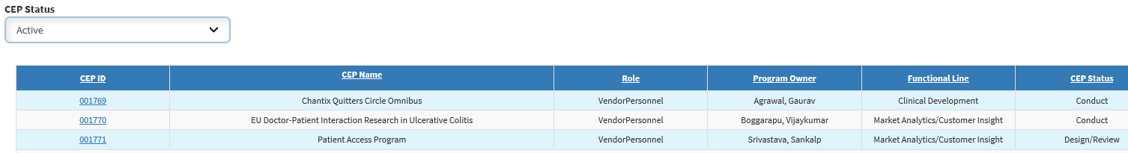
Troubleshooting LMS or LOS Access as a VPM (3/3)
Document Identifier: BQ-VEN-LOS-01 Version :1.0 Effective date: 01-May-2022

Slide 48

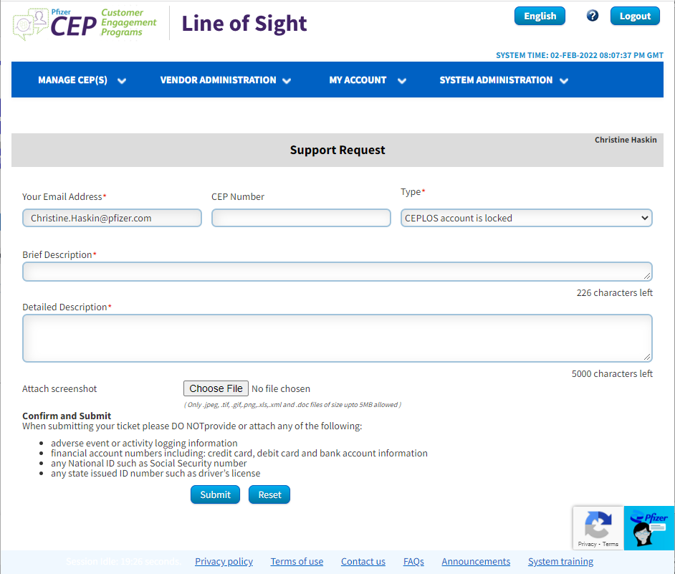
Troubleshooting LMS or LOS Access as Personnel
Any Personnel Can Use the “Get Support” Button to Report the Issue
  Click on the “Get Support” button
  If known, enter the CEP ID number (not required)
  Select the type of request from the dropdown list
  Enter a brief description or title
  Enter a detailed description
  If possible, attach a screenshot of the problem
  If LOS is down or inaccessible, please submit a ticket
  Tickets must be submitted in English
Document Identifier: BQ-VEN-LOS-01 Version :1.0 Effective date: 01-May-2022

Slide 49
Important Note for Programs Not Using LOS
  Be Sure to Follow All Existing Required Activities and Processes For Any Program that Is Not Being Tracked by LOS
  Collect signed training certificates
  Store signed training certificates for 10 years
  For LOS or Program process questions, please contact your Program Owner or Biopharma Quality (BQ) Lead
Document Identifier: BQ-VEN-LOS-01 Version :1.0 Effective date: 01-May-2022

Slide 50
If LOS Is Down or Inaccessible
Revert Back to Backup Methodology in Place for the Particular Communication Channel / Program Type
Capture any vendor personnel changes in LOS after the fact as needed
Document Identifier: BQ-VEN-LOS-01 Version :1.0 Effective date: 01-May-2022

Slide 51
LOS Makes It Easier for Our Vendor Partners to Comply with Pfizer Corporate Policy
LOS keeps a record of training status for vendor personnel and sub-contractors
LOS provides external inspectors and internal auditors, evidence
of compliance with Pfizer Corporate Policy 903
LOS will continue to improve with enhanced features
new
and
improved
Document Identifier: BQ-VEN-LOS-01 Version :1.0 Effective date: 01-May-2022

Slide 52
Your title goes here
Document Identifier: BQ-VEN-LOS-01 Version :1.0 Effective date: 01-May-2022

